Slide 1
PROJECT TRACKING SYSTEM

Slide 2
ABSTRACT
As the college in offline accessibility software, “PROJECT TRACKING SYSTEM” has helped staff to track and view student accessibility policies and practices, and leverage the best in accessibility in marks by this web-based application. In today’s college days with tight deadlines and overloaded work of staff, college organizations often need more than just a web product. The staff can easily find out the project status of each student with the help of our system.
With that in mind, staffs are now pleased to enter the Students project details through the offline software in one hand to enter and track their details. In same way it leads to very easy empowerment of software accessing one by the single staff to track the details very clearly, for this problem we need to track the students efficiently in such a way we have designed the Web based application to track it. The information about student project and their details can be generated as a report through the report option. To know the overall details the maintained information are extracted as report for any use.
The system has introduced for keeping the students project details in tracking manner, now the project has modules such as student’s entry, staff allocation to students as guide, project status tracking of students, at currently student has got how many marks, how many days absent to the review, title submission, guides reports are all view by online and allocation of project also done by online, with corrections, modifications etc

Slide 3
HARDWARE SPECFICATION
System : Pentium IV 2.4 GHz.
Hard Disk : 180 GB.
Floppy Drive : 1.44 Mb.
Ram : 8 GB.

Slide 4
SOFTWARE SPECIFICATION
Operating system : Android.
Front End : JAVA
Back End : MYSQL

Slide 5
EXISTING SYSTEM
Existing system of system of project management is manual. Project coordinator or guide gives task for student manually. Student complete the work which is given by coordinator or guide and submits manually, in this system all work is done by manually so it can take more time to complete project related work. Project coordinator or guide requires remembering in mind when student completed the work so it is difficult for Project coordinator or guide which student completed the task and when. In the existing system does not help users to get right information at right time and user cannot manage project development easily to achieve the main goal. Limitations of existing system

Slide 6
DISADVANTAGES
It is time consuming
Right information is not retrieved at right time.
Any updates to the data by team members or the Project coordinator or guide cannot see immediately by the rest of the team.
All work is done manually.

Slide 7
PROPOSED SYSTEM
In this proposed system we can implement a system which can manage project cognate all work consummated by utilized and Project coordinator or guide. Coordinator updates project cognate information, view work done by a student at which time and view progress chart of work done by student, progress chart is developed utilizing Student retrieved the given work information updates and consummates this work at given time and submits into the project management system

Slide 8
Modules
Admin Login
This module admin can able login into the application and perform an action to managing the student project tracking. Admin can have all the access to do the bellowed modules activities.
Student Registration Form
This module admin collects the all the information from the student and stored into the student table. Student table have all the requested field to map the application. Once the student has a mapped before should create the registration form.

Slide 9
Project Allocation
Admin compare the technology wise student to allocate the student to the particular project. Once all the students are allocating into the particular project their list will be showing into the project status window.
Student Details
Here we can able view the all the student details and allocating project details as well. A cumulative report can we collect here for the user. We can check the student count and student project details.
Pending & completed project status
This module will show the user for displaying the pending and completed project details. Admin can easily check the current status of the all the project in a single window.

Slide 10

Data Flow Diagram
Level 0

Slide 11
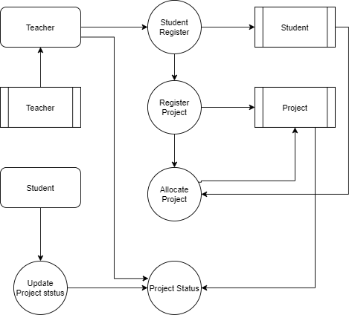
Level 1:

Slide 12
TABLE NAME : ADMIN
FIELD NAME | FIELD TYPE | SIZE | CONSTRAINT
Id | Int | 10 | PRIMARY KEY
Username | Varchar | 15 | Not null
Password | Varchar | 20 | Not null

Slide 13
TABLE NAME : STUDENT
FIELD NAME | FIELD TYPE | SIZE | CONSTRAINT
Id | Int | 10 | Primary key
Name | Varchar | 15 | Not null
Rollno | Varchar | 15 | Not null
Department | Varchar | 15 | Not null
Classname | Varchar | 15 | Not null
Username | Varchar | 15 | Not null
Password | Varchar | 15 | Not null
Guide | Varchae | 15 | Not null
Mobile | Varchar | 15 | Not null

Slide 14
TABLE NAME : PROJECT
FIELD NAME | FIELD TYPE | SIZE | CONSTRAINT
Id | Int | 10 | Primary key
Title | Varchar | 30 | Not null
Description | Varchar | 30 | Not null
Modules | Varchar | 100 | Not null
Technology | Varchar | 100 | Not null

Slide 15
TABLE NAME: ALLOCATE
FIELD NAME | FIELD TYPE | SIZE | CONSTRAINT
Id | Int | 10 | Primary key
Student_id | Int | 10 | Foreign key
project_id | Int | 10 | Foreign key
status | Varchar | 30 | Not null

Slide 16
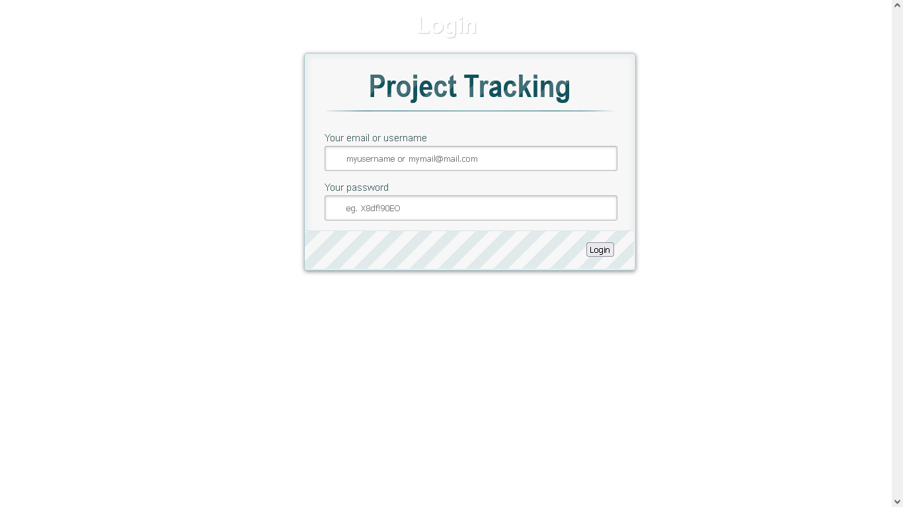

Slide 17
Thank You

